Slide 1
Google
Colab(oratory)
Presented by Tom Lafferty
Zip Code Wilmington Data Cohort 2.2

Slide 2

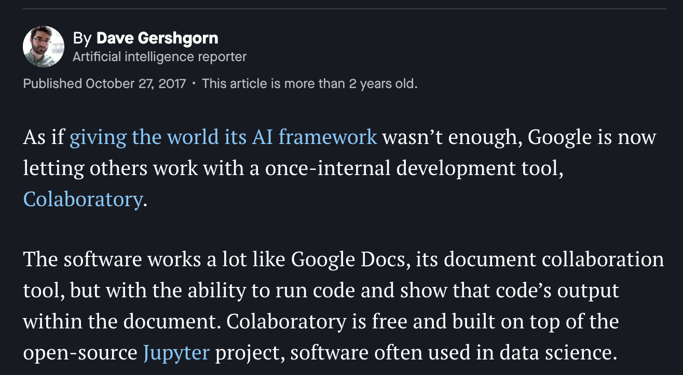
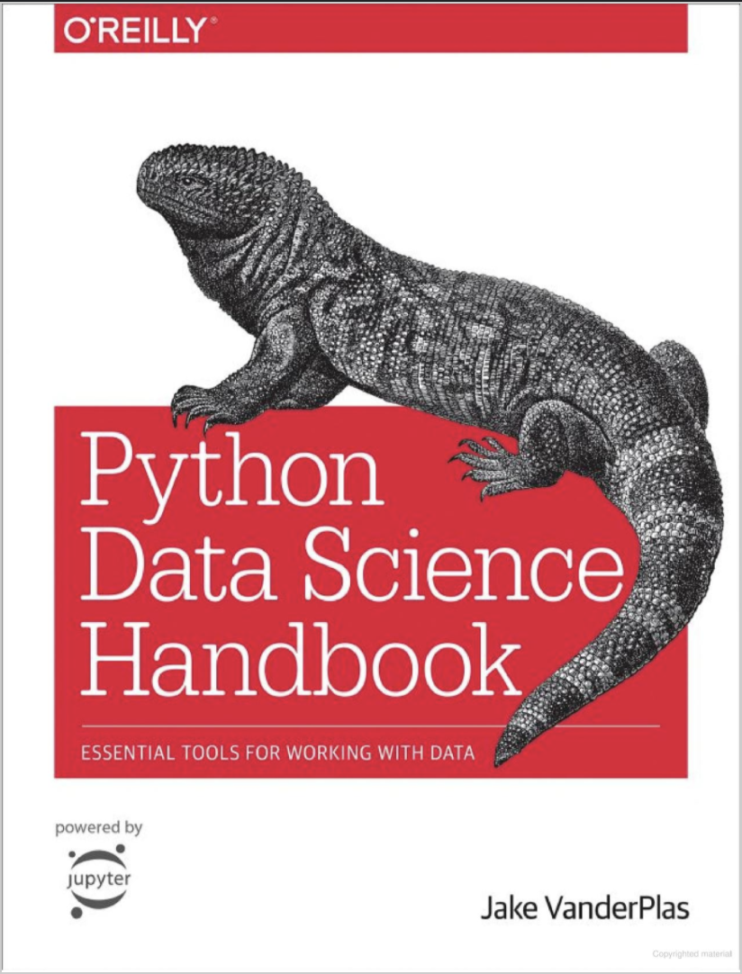
coLaboratory -> Colab
Created in 2014 by Google Research working with the IPython/Jupyter development team, as well as Matthew Turk, creator of the popular yt visualization package, as an internal tool
Merges successful open source projects with Google products
Cloud based Jupyter Notebook editor for writing and executing Python in a browser
Jake VanderPlas - Google Colab Software Engineer + author of Python Data Science Handbook

Slide 3
Features:
Cloud based
Zero configuration required
Don’t have to download, install, or run anything
Versioning: save to GitHub without terminal commands
Sharing
Integrated with Google Drive and other Google projects
Easily share with or without permissions, no need for use of email
Compatible with other Jupyter Notebook projects, full power of popular Python libraries
AI / Machine Learning / TensorFlow
Leverage computing power of Google servers to train classifiers
Hardware boosters with free GPU and TPU
Seedbank project
Colab notebook community
Code Snippets

Slide 4

Jupyter & Colab
Both now free open sourced projects
Both write and execute Python and MarkDown text
Both relatively user friendly
Both can be run in browser

Slide 5
Jupyter VS Colab
CPU based
Hardware based on what you have
Files from Google Drive
Free
Can work locally
Cloud based
Leverages Google servers
Hardware accelerators
GPU
TPU
Files from machine
User-friendliness
Code snippets
Shortcuts
Pro version $9.99/m for prioritization / all features
Works through Google Drive products

Slide 6
When to use
Google Colab
>
Jupyter Notebook
AI / Machine Learning
Can start and run projects without anything but a browser
Free GPU
24 hour sessions
Collaborating through Google Drive
No need to copy, email notebooks
Simplicity of working in tandem, leaving comments in real time
No need to git add, git commit, git push or pull

Slide 7
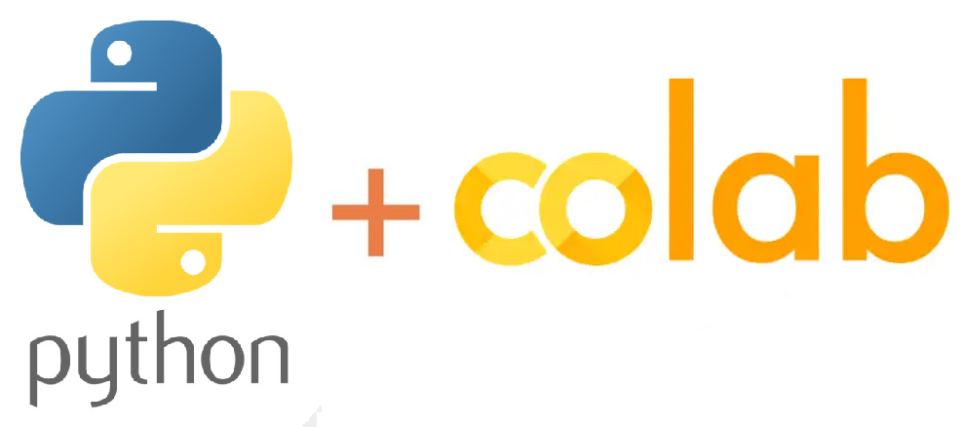
Recommendation
As a budding Data Engineer with Python as my base language, I would like to familiarize myself with Google Colab.
Google is recognized as an industry leader, and for their work in AI and machine learning, and it is clear this tool was developed on top of Jupyter Notebook with that in mind.
Working exclusively through Google Drive or having to upload files to work from every time isn’t the most convenient, but I can see many situations where it is worth it.
Also as a newer Data Engineer, the built in support tools from the Google team seem to be very powerful tools.

Slide 8

Fin.

